Slide 1


Slide 2
Navigation problem at EJUST
Made By George Anton Mohammed Waleed Youssef Ahmed Ziad Abdelsamee Marawan Abdelrazzak

Slide 3
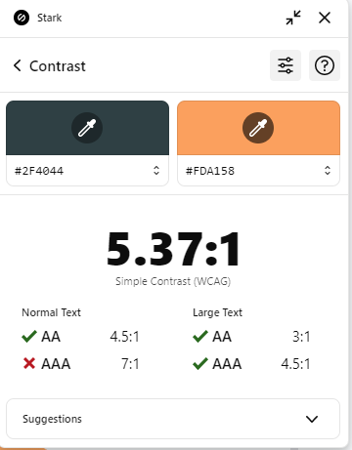
How many times you got lost ?
Here is where problem begins

Slide 4
Our Main Problem:
01
02
?
The lack of any means of guidance towards all the Main Campus’s facilities
?
?
People being late to their lectures and getting lost in the main campus
?

Slide 5
So,We asked in survey the following questions
1. Have you ever been Lost in the Main Campus?
2. Do you still have a hard time knowing the locations in the Main Campus?

Slide 6
And that was charts of the answers

Slide 7
So the possible solutions inspired from survey :
Snapchat GeoFilters
Google Classrooms
Website
That solution was selected :
Can be well-organized
Fits our team abilites
Can be used by every one on every device

Slide 8

The Guide for indviduals
at E-JUST

Slide 9
Pros
Simple design and really easy to use by Freshmen
Contains rooms,buildings,restaurant and … etc
Easily accessable
Cons
Still under testing and checking

Slide 10
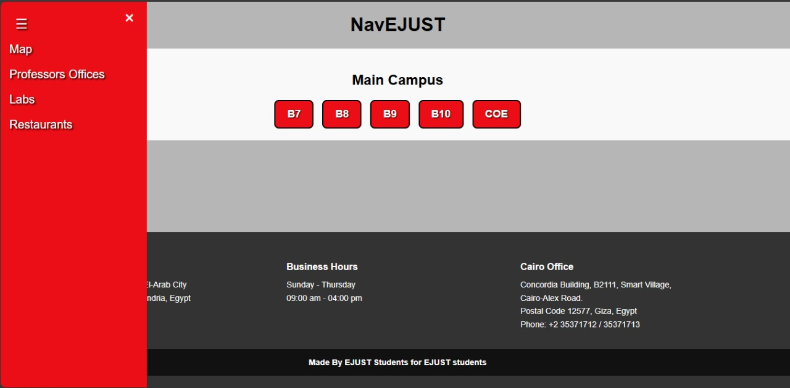
Final solution
Website that includes:
Interactive maps
Professors Office locations
Labs locations
Resturants
Info of each Building
A simple visualization of the final form

Slide 11
We are open for recommendations to add to our website Feel free to notify us about it !!!

Slide 12
Thanks!
Do you have any questions?

